Slide 1
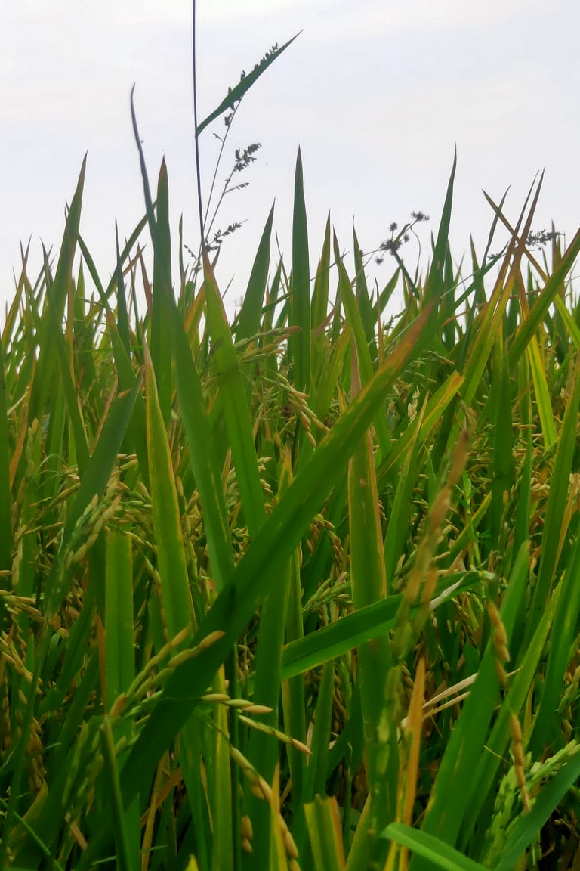
Hackathon 2.0 She-the force Hack for sustainability
Go Farm!
Team: Wonder Women
Vani N Swapna A Srinivas Athiya Hanisha Sowjanya

Slide 2

Agenda
1
Theme & Opportunity for us
2
Current State
3
Proposed Solution and flow
4
Road Map

Slide 3
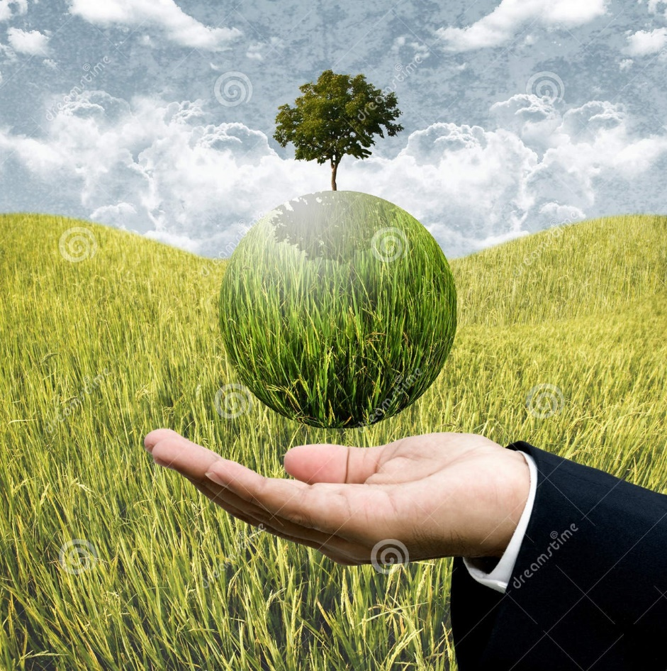
Agriculture Challenges during Pandemics
Farming has always been one of the most important economic activities in India. With about two thirds of the population engaged in agriculture and agriculture related activities. It is important to understand the plight of farmers and understand why they are suffering.
In the context of Agriculture, sustainability refers to the successful management of agricultural resources to satisfy human needs while at the same time maintaining or enhancing the quality of the environment and conserving natural resources for future generations.
The challenge we see today is farmers that they do not have enough consumer base for organic produce and consumers do not have awareness about it to address this, we want to build a solution which brings the producers and consumer together and creates a win-win situation for both.

Slide 4
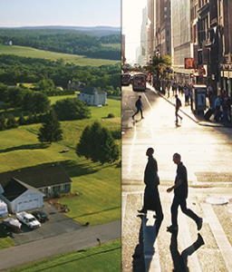
GO FARM – Experience one day of Farming in Live !!!
Go Farm is a new business idea to strengthen the connection between rural and urban people, grow farm visits, and provide a new Agri-tourism income stream for farmers.
Today, a visitor to a rural area has no easy way to visit a farm unless they know someone personally, who either owns farms or knows about other farmers.
Go Farm as an online platform, gives consumers the opportunity to book a day, to experience unique agricultural feeling, by giving an opportunity to participate in few farming related activities and meet farmers directly in areas they choose.
Go Farm is predominantly about experiencing nature and respecting its treasures in a way that future generations will be nurtured with good things and cherish for green living.

Slide 5
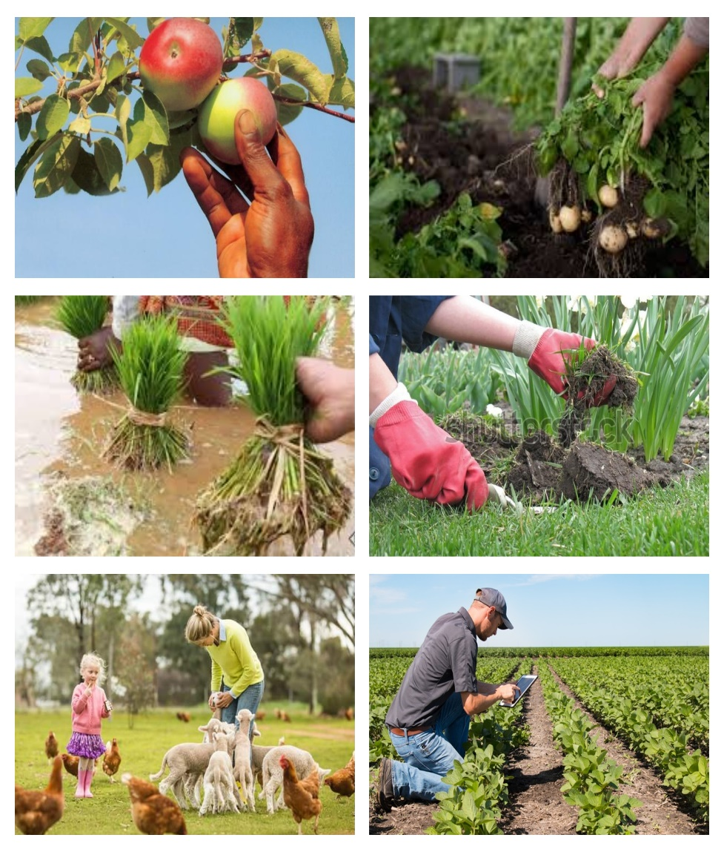
Plan a Day at Farm A Step Close Towards Farmers!!!
Away from the routine buzz and noise of the city Life, enjoy your day in the lush green Farms along with farm animals like cow, ducks, turkeys, hen, rabbits etc.
Have unique on-farm Live experience for some time or a whole day !! Until your legs & hands get dirty ☺
.
Spend a day with farmer, like a farmer!
Pick the produce directly from the farm. You can pluck vegetables/fruits directly from plants. Or help farmers pick the grains.
You can buy the produce straight from farm to your kitchen!

Slide 6
Go Farm Current capabilities
We will be able to plan the full day or partial day for the consumers with variety of events related to farming.
All these activity info would be shared in Go-Farm tool, so that users can choose them as per their interest.
We will also maintain track of these activities to show user as what they have done in previous visits.
Plan & Track Activities
Good platform to showcase their produce directly to consumers. henceforth they can build the bonding with consumer.
Securing Consumers for maintaining Market opportunities for the Produce
Any one can login into the GO farm web page through simple registration.
Get the awareness about Farming life. They can personally feel pains and gains of farmer
Register to GO FARM
Market Place for Produce
GO
Farm
Visitors/Consumers Can schedule a day to spend in the Farm , by providing details like no of persons, activities that they want to participate etc
Spend a day on a typical farm, where you can see and experience a number of farming activities. Depending on the season you can take part in working in the fields, peeling corn, sowing seeds, harvesting the produce.
Schedule a day at farm
Recycling the Farm waste
Provision to recycle the organic farm waste, left after the farming.
This waste can be used for feeding farm animals.
In some cases this would be recycled to develop compost and used in next crops.

Slide 7
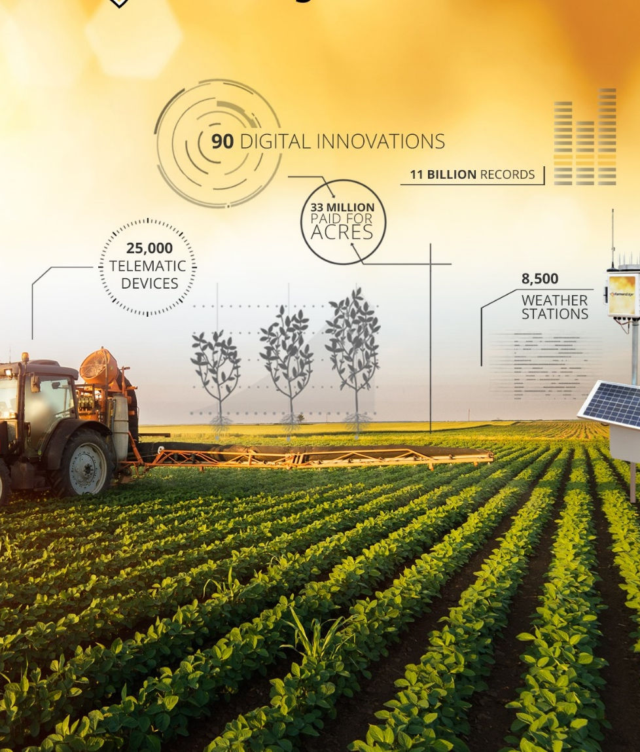
Go Farm– Road Map
Track activities of visitors , ability to post the pictures/videos in the site
Chat bot to provide solution in local language of Farmers on their issues and concerns
Access to Tutorials for Organic Methods for cultivation and help line for same
Market space for Farmer’s Crops sales
Awareness Tutorial on how to increase ground water in Farms

Slide 8

Thank you!!

